Slide 1
CS Auburn / USDA Updates
3 October 2024

Slide 2
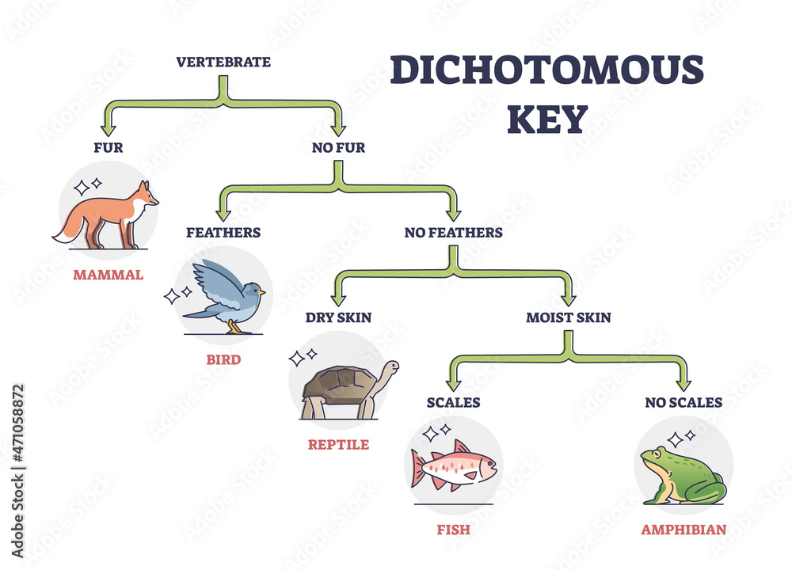
Random Forests (Background)
This method largely replicates that of Willett et al.
Decision Tree: like a dichotomous key, but automatically generated for a dataset to maximize the likelihood it makes a correct classification.
Random Forests Model: a large collection of decision trees all trained slightly differently from each other (this gives them some diversity in the way they “think”). We poll all of them and we go with the majority to make our decision.

Slide 3
Random Forests (Preprocessing)
To make the recordings a bit more palatable for the model, we perform the following process on each of them before we hand them off.
Cut the recordings into sequential 1 second chunks.
For each chunk, we extract the
Most common waveform label (this is what the model is trying to predict)
Mean voltage value
Standard deviation of the voltage values
Input voltage used during the recording (same for all chunks from the same recording)
Current type, either AC or DC (same for all chunks from the same recording)
Time of the first datapoint in the recording
Top 6 Frequency Components (i.e., those with the largest magnitudes found using a Fourier transform)
These extracted values are then handed off to the model for training. To be clear, the model uses features b-g to predict feature a.

Slide 4
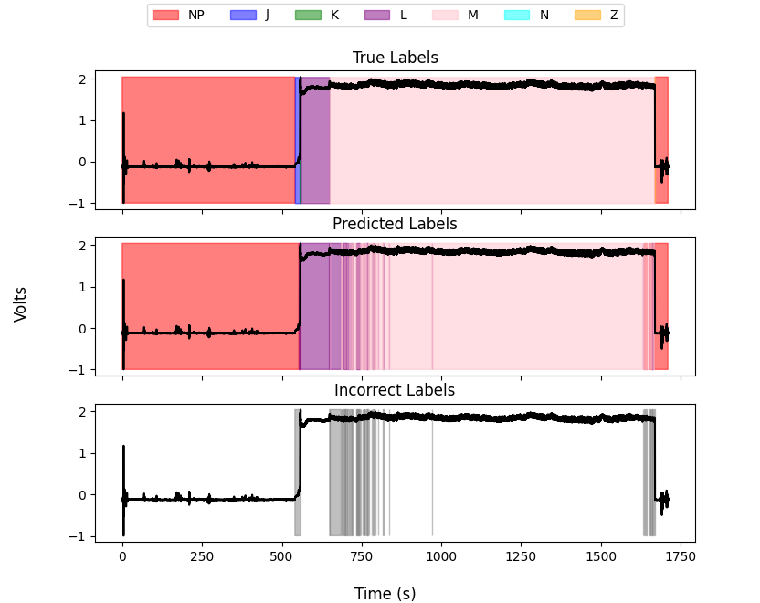
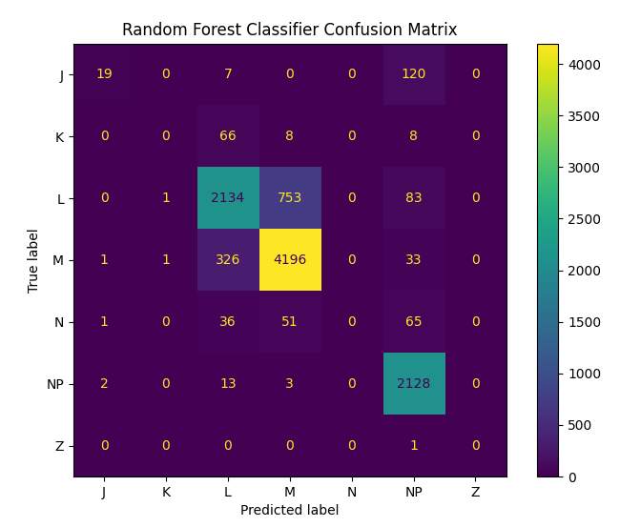
Random Forests (Results)

Slide 5
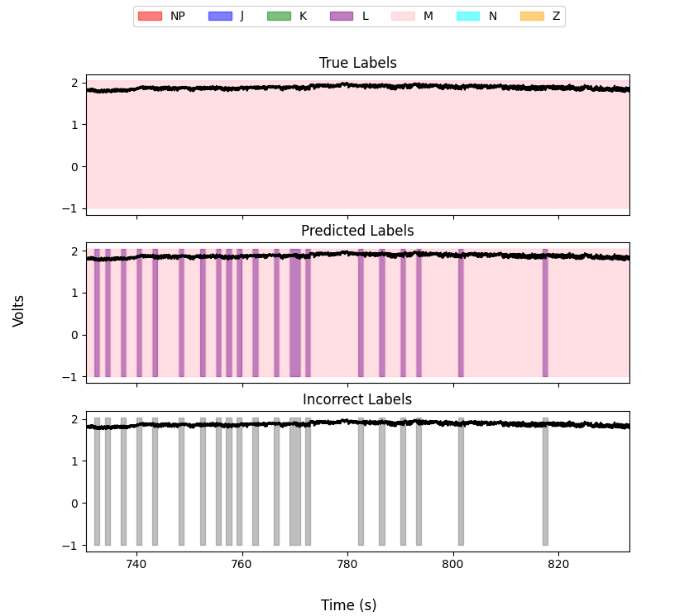
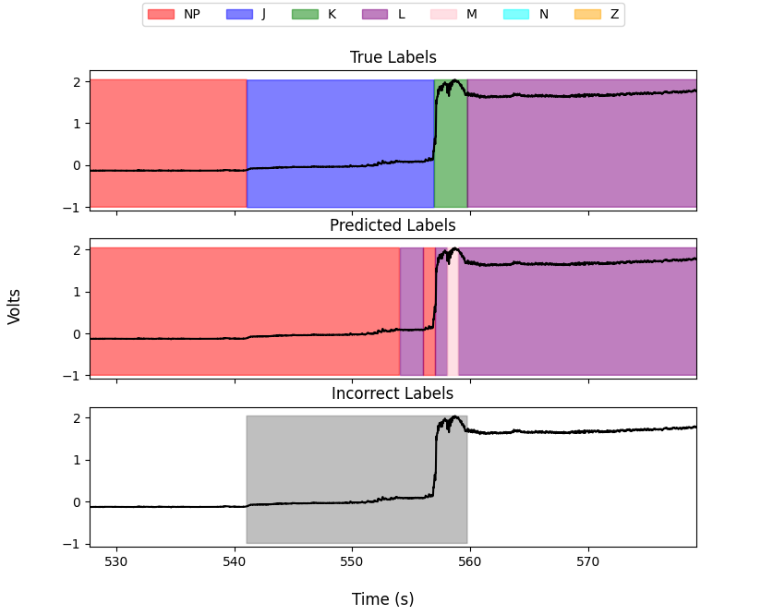
Random Forests (Issues)
Barcoding
Ignoring J and K

Slide 6
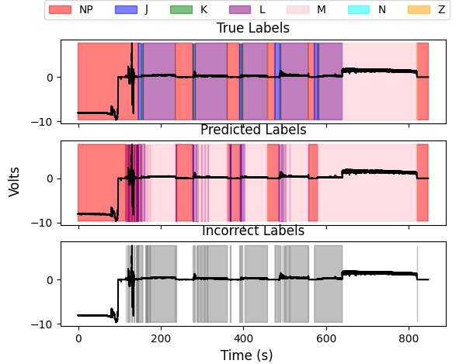
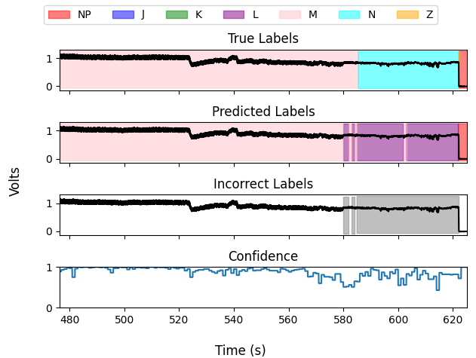
Random Forests (Issues)
Poor Performance with Repeated Probes
Skipping N

Slide 7
Random Forests (Next Steps)
Barcoding: This can be easily solved by applying a filter after the fact that replaces very short changes in waveform label with that of the labels surrounding them (think of this as just de-noising the output)
Ignoring JK and N, Repeated Probe Performance: Currently, the model has a very “short sighted” point of view because it only sees one second at a time and knows little about the overall structure of the waveform. Fixing these problems will likely require supplementing or replacing random trees with a method that is more aware of the overall structure of the waveforms, especially with regards to the transition matrix. This may be either a post-processing step or another model entirely.

Slide 8
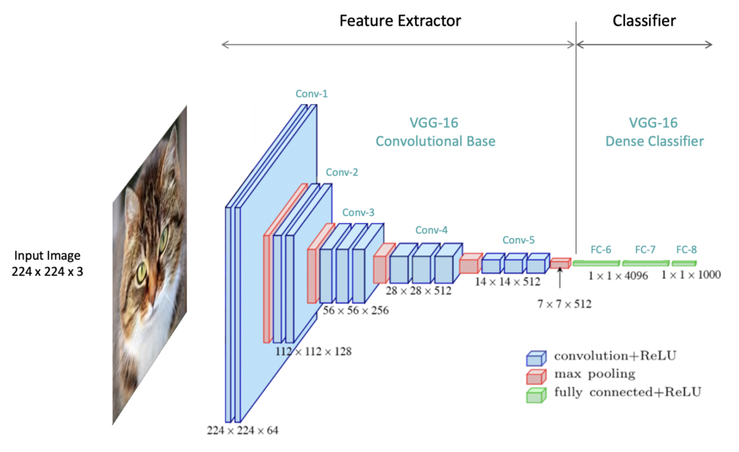
CNNs (background)
Convolutional neural network
Commonly used for images
Usually the convolutional layers extract features and then some classifier learns to use those features for prediction.

Slide 9
CNNs (results)
~80% accuracy, don’t have confusion matrices yet but this is a very preliminary model

Slide 10
CNNs (issues)
I don’t have the memory to train on longer historical timespans. I am redesigning the system to be more efficient. Once we give more context to the model it will likely perform a lot better.
As the lookbehind gets larger the size of the model (defined as # params) grows very fast. Using techniques from temporal convolutional networks (TCNs) to mitigate this issue such as exponential dilation.

